Slide 1
Introduction to SnX
SnX is a cutting-edge 3D outfit customizer that revolutionizes the way people interact with fashion. It provides an immersive experience, allowing users to create and customize their unique style in 3D.
By:
Abdurrahman Qureshi
Oaish Qazi
Hussain Shaikh

Slide 2
Background
Motivation
Approach
Traditional offline outfit shopping methods no longer meet modern preferences, and even online shopping lacks a comprehensive solution for users to fully express their style.
The project utilizes 3D tech for an immersive, interactive shopping experience, empowering users to design outfits, fostering creativity
The platform offers premium models and a wide array of tools for users to meticulously design their dream outfits.

Slide 3
Scope
Objectives
The "3D Outfit Customizer" lets users design outfits in a 3D environment. With diverse clothing options, decals, patterns, and accessories, they can visualize designs on a virtual model. They can share and order custom outfits,.
To Study 3D Outfit Customizer Systems.
To Curate a diverse collection of clothing items, fabrics, styles, patterns, and accessories.
To Enable users to design and personalize outfits in a 3D virtual environment.
To Provide an immersive and interactive platform for users to express their unique style.
To Offer a user-friendly interface accessible on various devices.

Slide 4
Problem Statement
“Verily, in the realm of online shopping, platforms oft lack the essence of personal touch, depriving souls of true self-expression. The fashion domain suffers from a dearth of comprehensive 3D customization, leaving hearts yearning for depth and resonance. Our endeavor, a 3D outfit customizer, emerges to bestow power upon users, reshaping the digital tapestry of fashion with innovation and verve.”

Slide 5
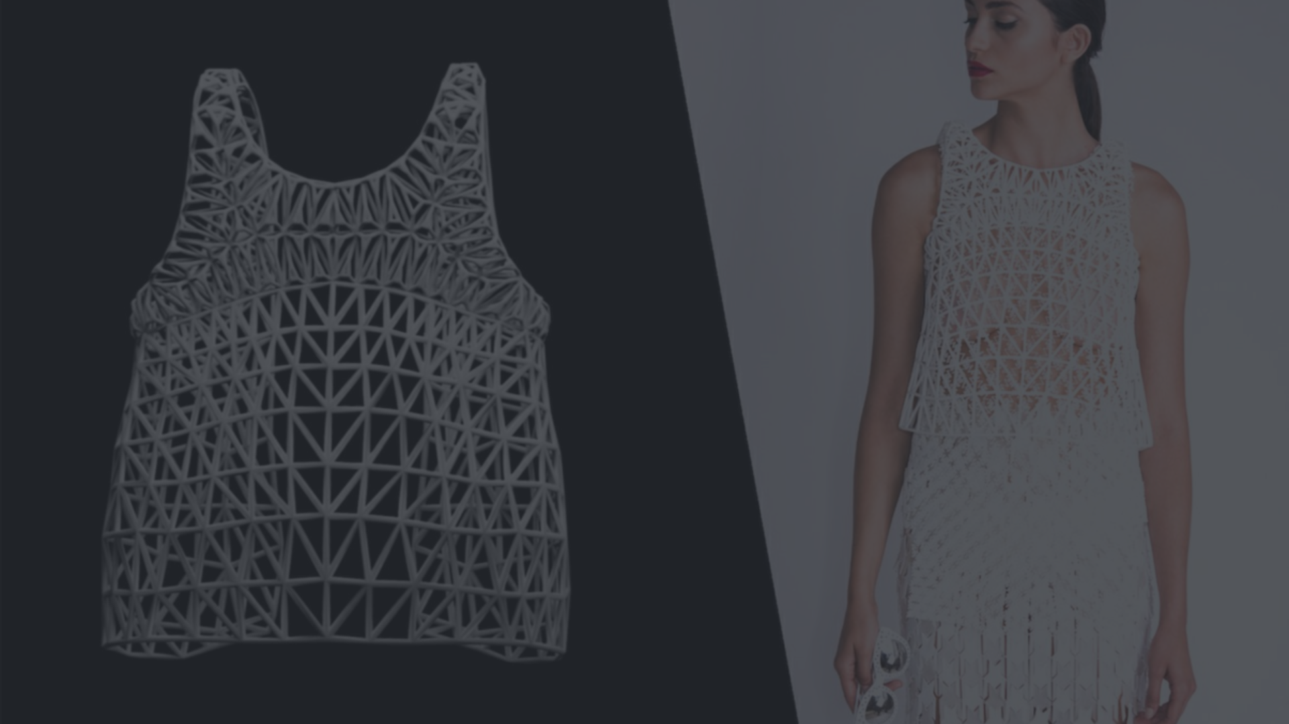



Features
Design Creation
Visual Customization
3D Preview
Users start by selecting the clothing items and accessories to customize their outfit.
They can then modify colors, patterns, and decals to match their individual preferences.
While designing, they can view a lifelike 3D representation of their creation from any angle.

Slide 6
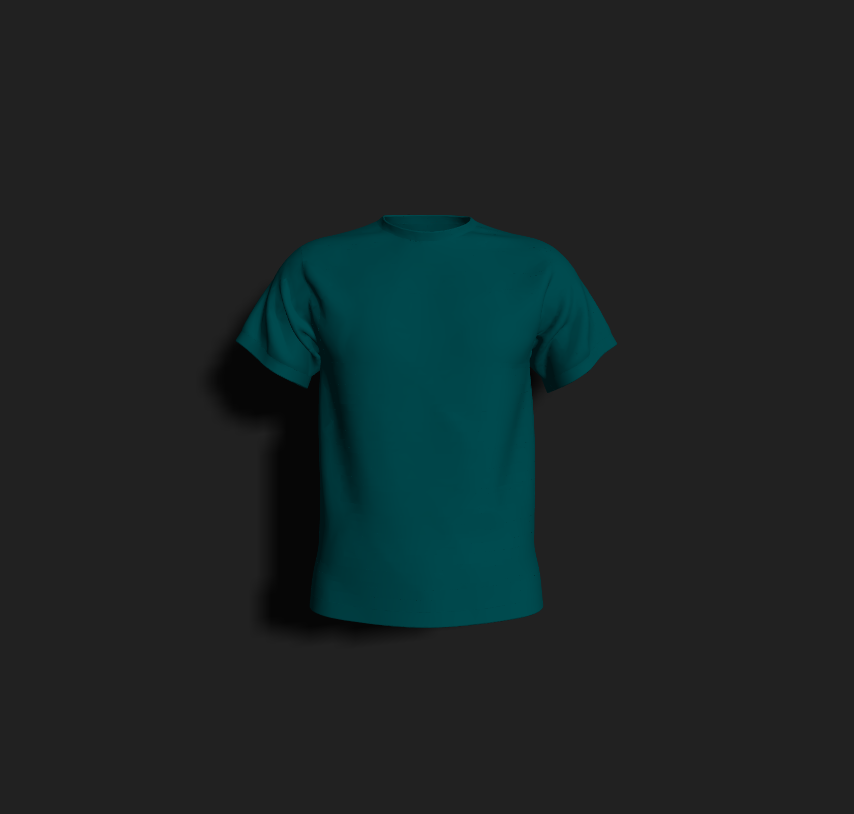
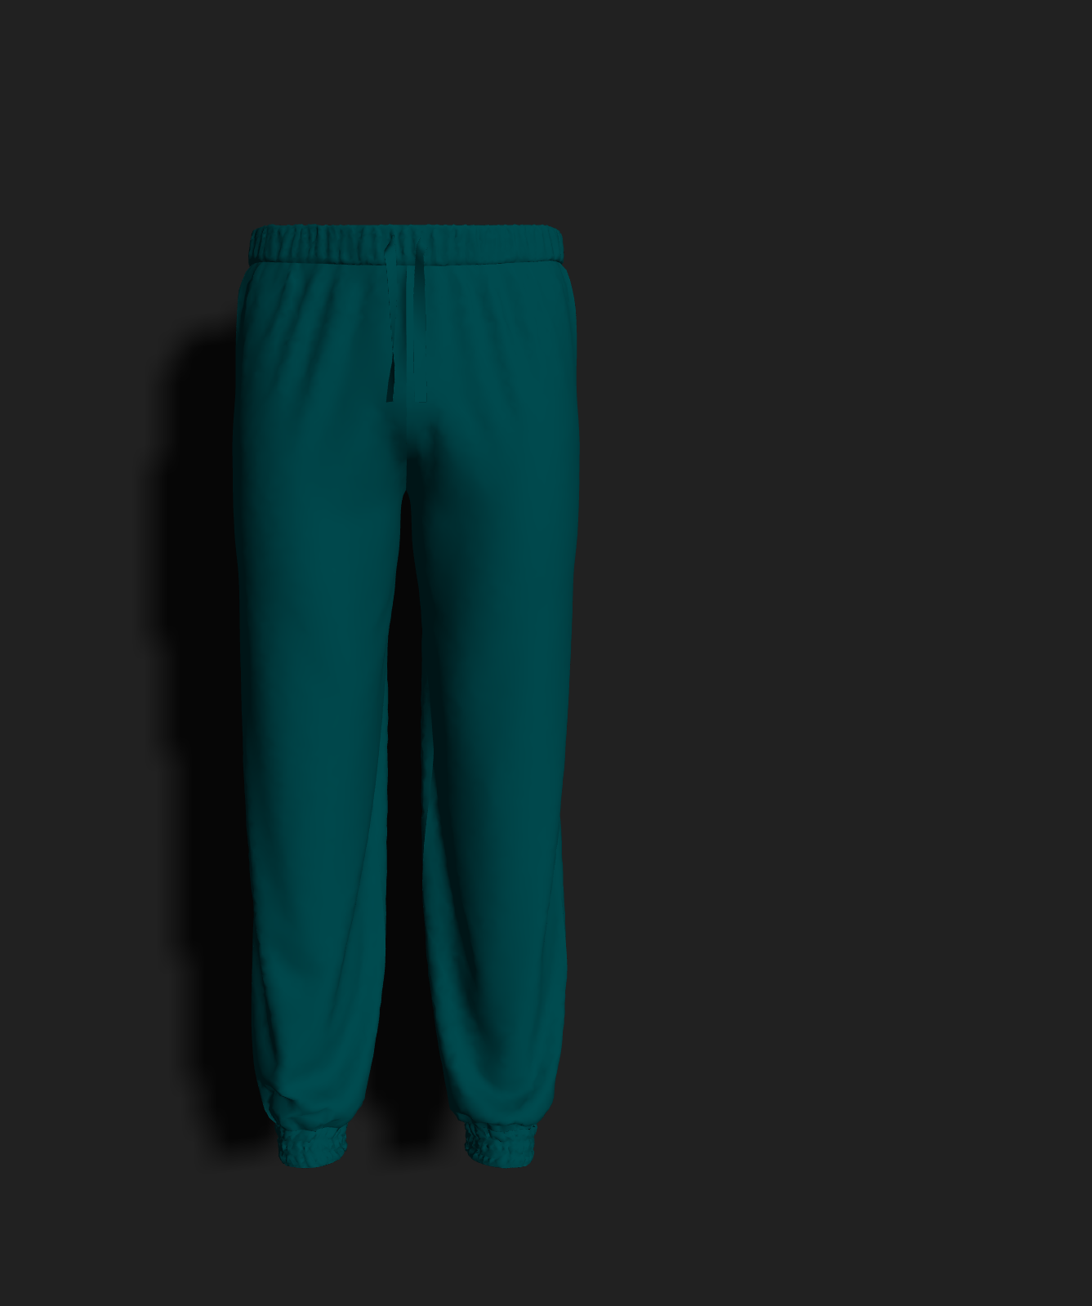
Benefits of using SnX
1
Creative Expression
2
Time-Saving
3
Social Sharing
Empowers users to express their unique style and creativity through personalized outfit designs.
Saves time by providing a virtual platform for trying out and visualizing different outfit combinations.
Enables users to share their creations on social media, garnering feedback and appreciation from peers.

Slide 7
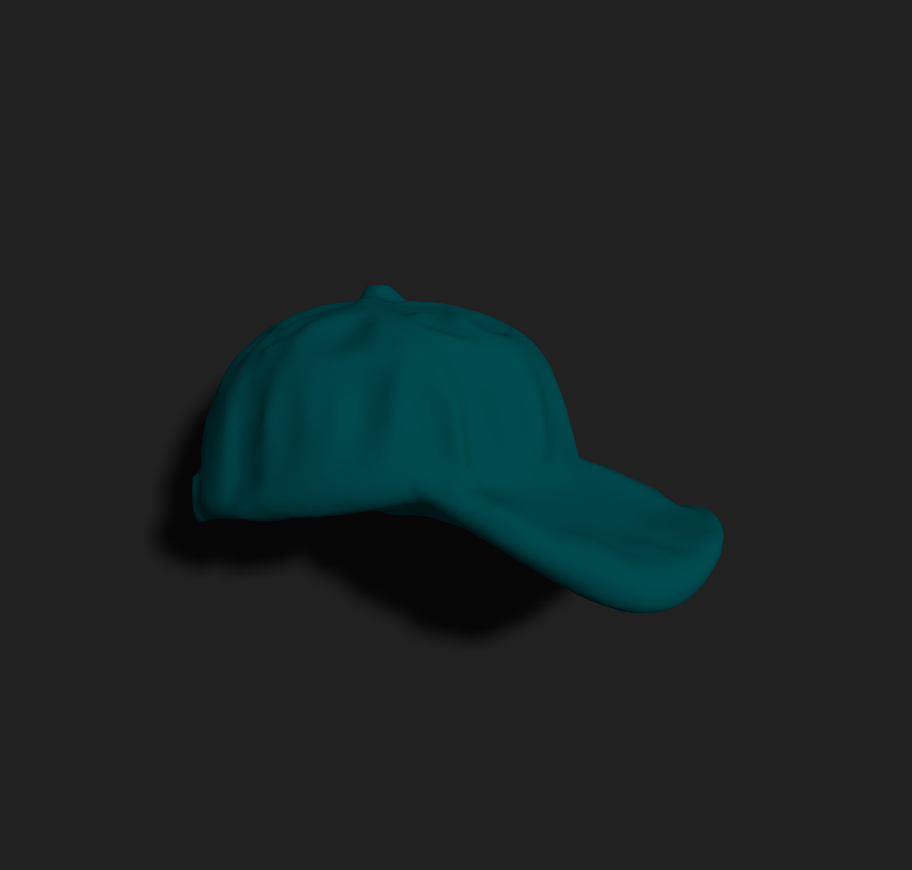
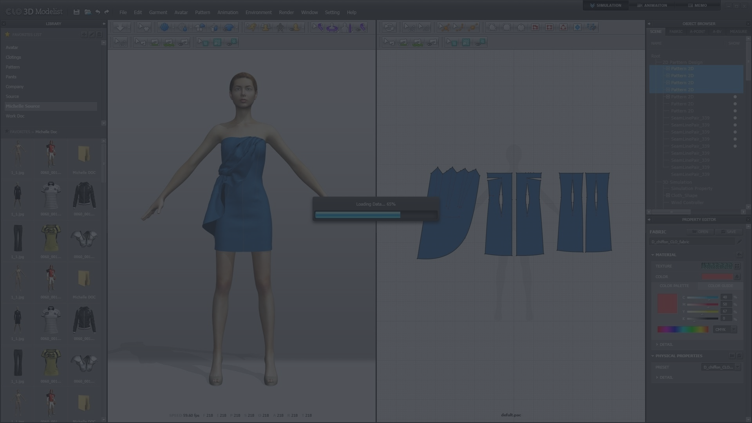
Demerits of SnX
Disadvantages
Limitations
Compatibility issues with certain devices or browsers.
Requires mid-to-high. end machines.
Custom tailored sizes aren’t available.
Vast number of decals may affect performance of the app.
Large database can alter response time of the app.
“Verily, custom models doth not find favor in this realm of creation.“
Realistic depictions of model textures and materials are not feasible.
Specific parts of the models can’t be customized.

Slide 8
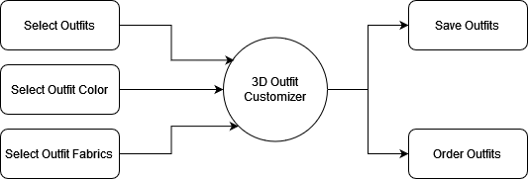
Block Diagram

Slide 9
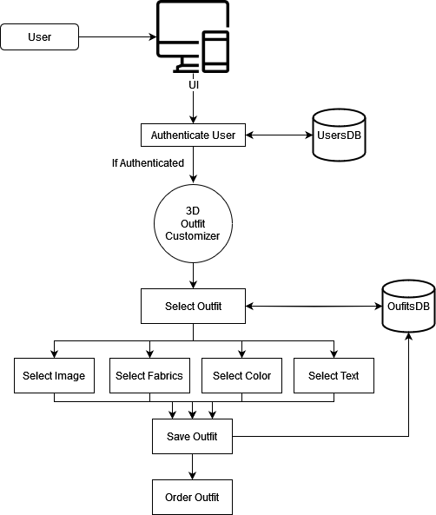
System
Architecture
Diagram

Slide 10
OUTPUTS

Slide 11
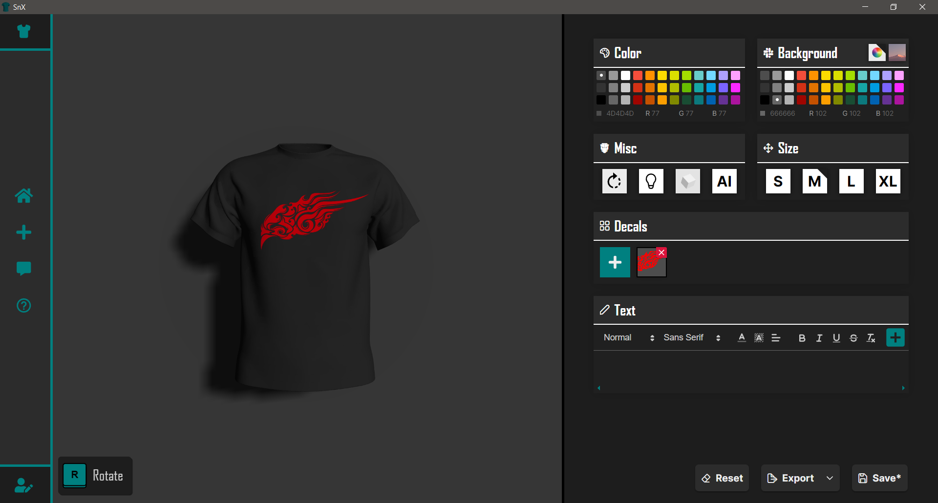

Slide 12
